Slide 1
ECAS Pictures C

Slide 2

Can you name or describe this picture?

Slide 3

Can you name or describe this picture?

Slide 5


Slide 6


Slide 7


Slide 8


Slide 9


Slide 10


Slide 11


Slide 12


Slide 14









Slide 16


Slide 17


Slide 18


Slide 19
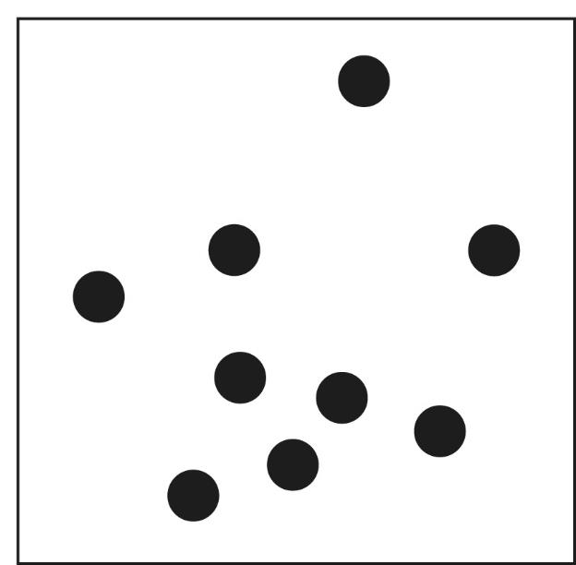

Slide 21
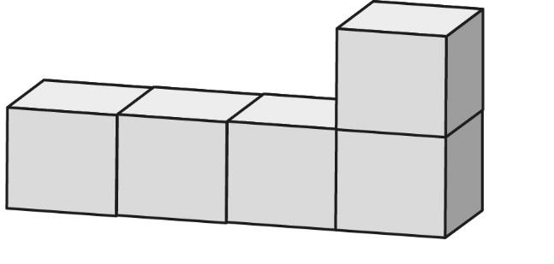

Slide 22
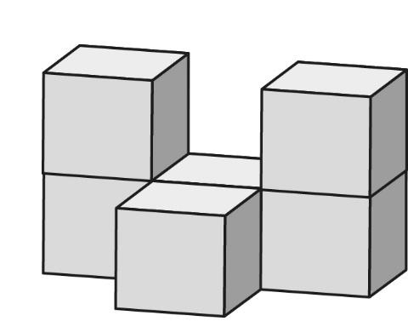

Slide 23
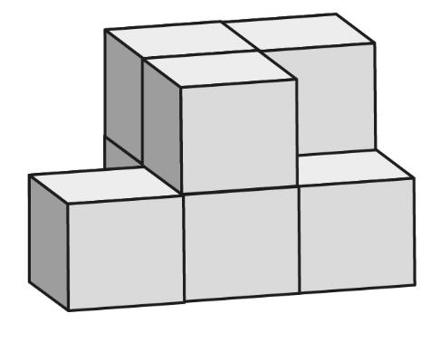

Slide 24
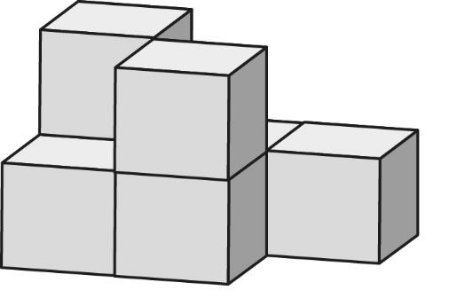

Slide 26
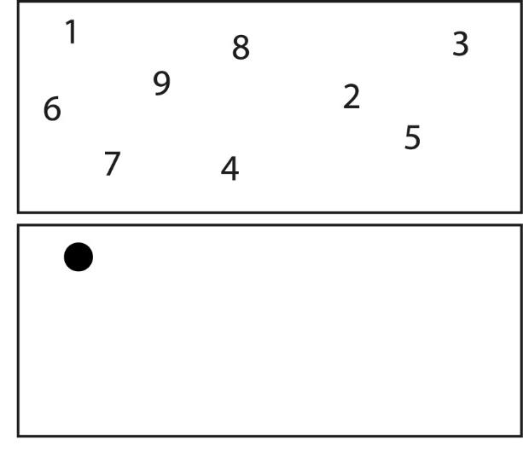

Slide 27
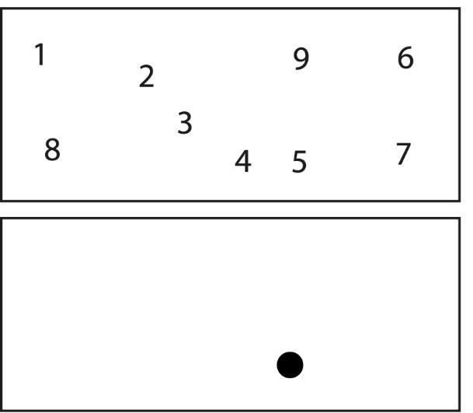



Slide 28
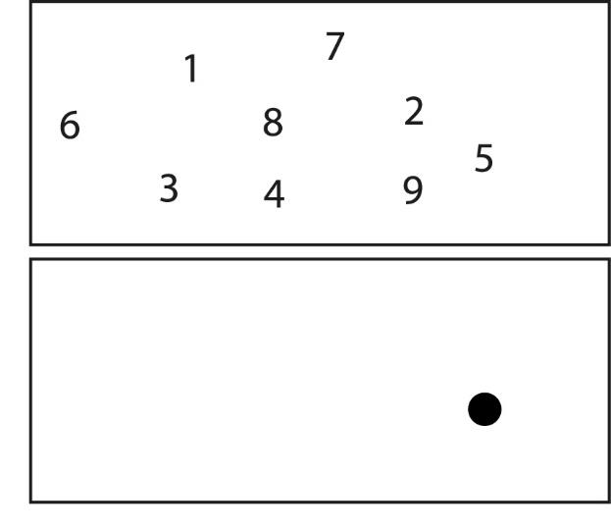

Slide 29
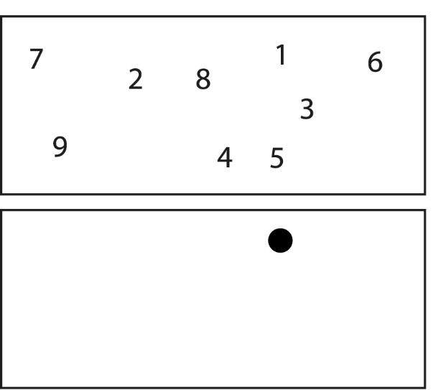



Slide 31





Slide 32





Slide 33



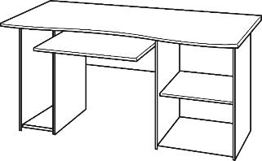

Slide 34



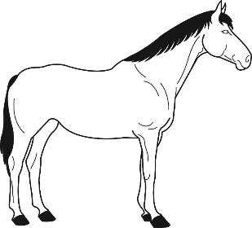

Slide 35





Slide 36

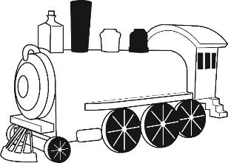



Slide 38


Slide 40


Slide 42


Slide 46


Slide 50
Thank you!

