Slide 1
ECAS Pictures A

Slide 2

Can you name or describe this picture?

Slide 3

Can you name or describe this picture?

Slide 5


Slide 6


Slide 7


Slide 8
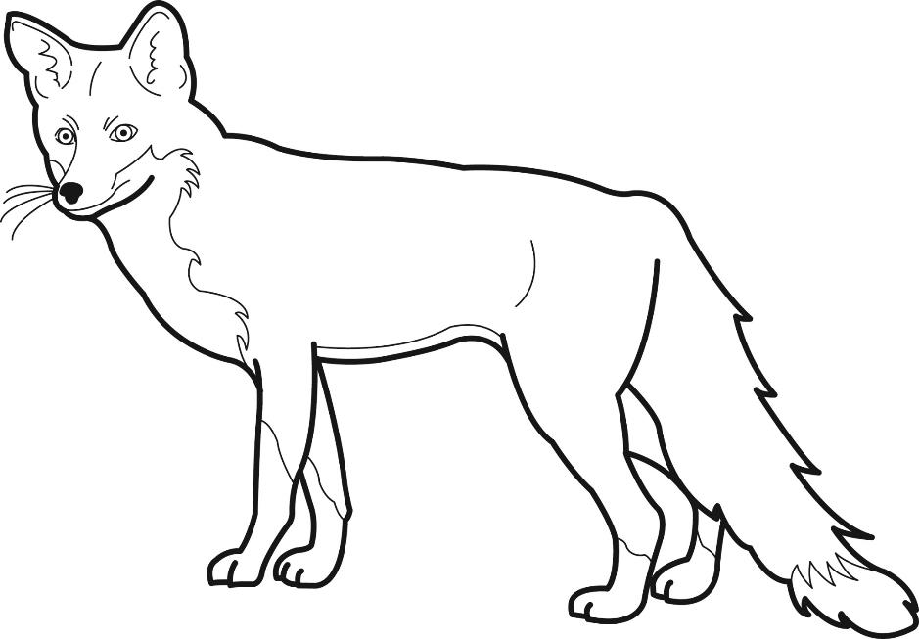

Slide 9


Slide 10


Slide 11


Slide 12


Slide 14


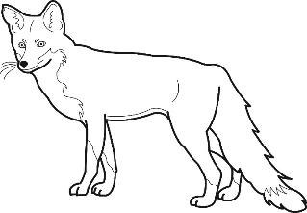






Slide 31





Slide 32





Slide 33



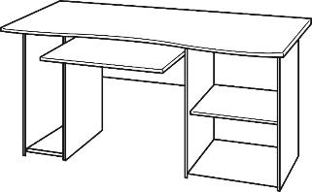

Slide 34



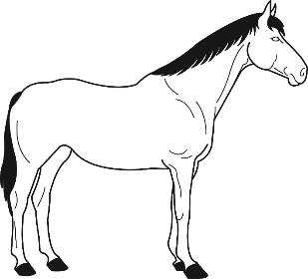

Slide 35





Slide 36

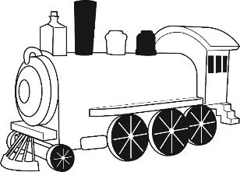



Slide 38


Slide 40


Slide 42


Slide 44


Slide 46


Slide 48


Slide 50
Thank you!

